Slide 1
DDS Analytics for Talent Management – Case Study 02
By: Antonio Debouse
MSDS 6306: Doing Data Science

Slide 2
Introduction
Employee break out by Job Title
Categorical Variables
Continuous Variables
Attrition
Overall attrition rate
Analysis of attrition based on job title
Variable Predictors
Modeling
Naïve Bayes (Attrition)
kNN (Attrition)
Multi-linear Regression model (Salary)

Slide 3
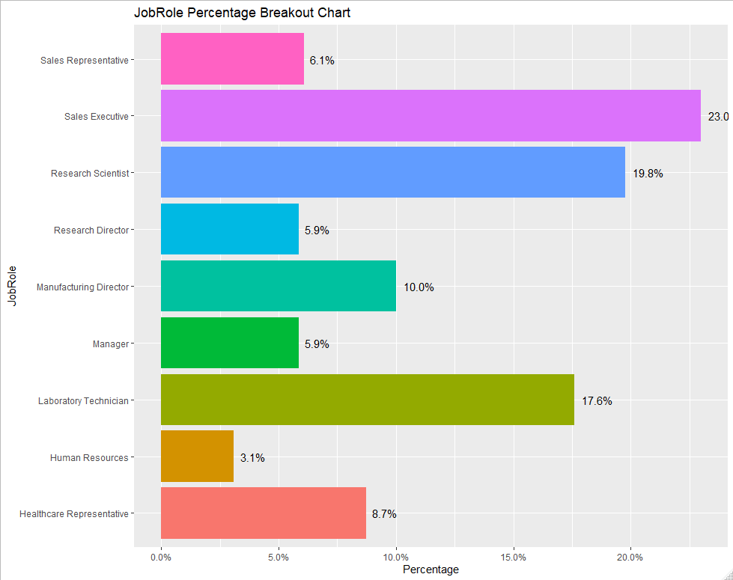
8)
Total of 870 current and formal employees
Note: Healthcare Representatives, Managers, Manufacturing and Research Directors have turnover rates higher than 84%
1)
2)
6(tie)
4)
6(tie)
3)
9)
5)

Slide 4
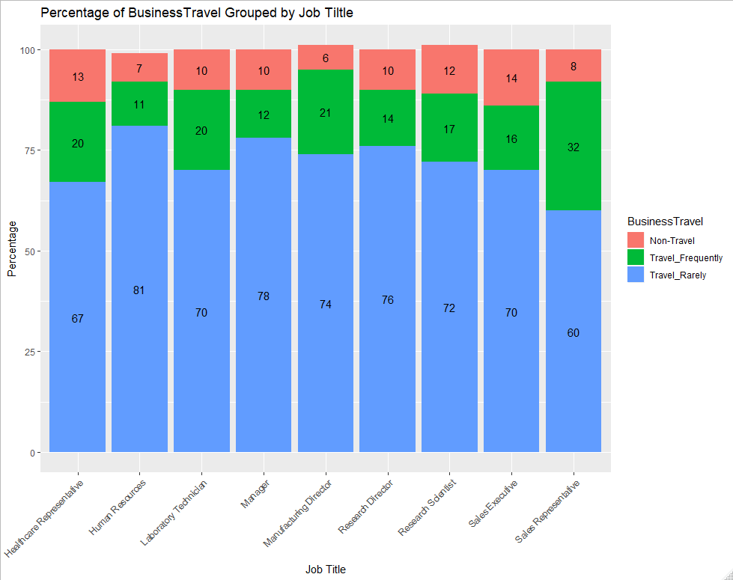
Not surprising to see Sales Reps, Healthcare reps, and Manufacturing Directors among the higher Frequent travelers
Is surprising to is Lab techs on average are higher frequent travelers than Sales Executives

Slide 5
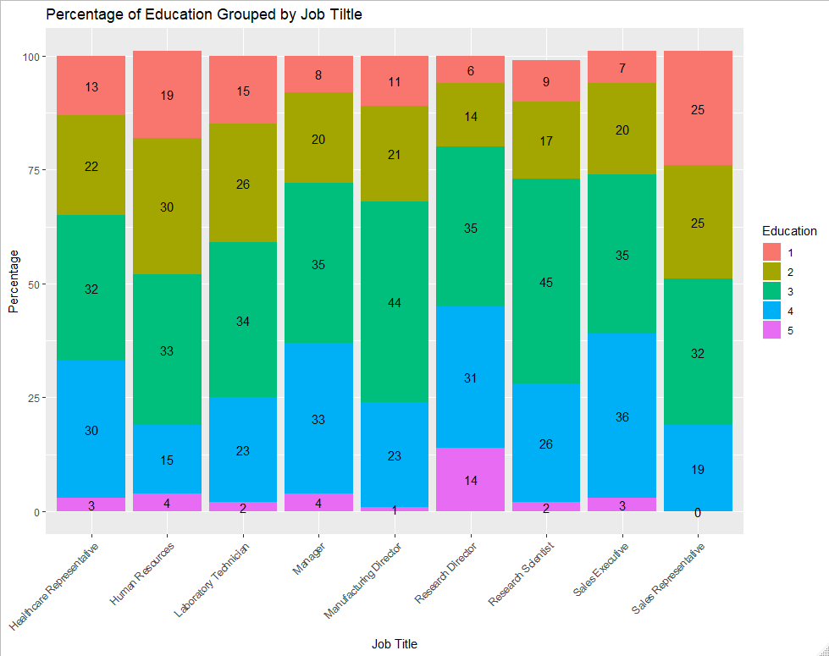
Research Directors have the highest frequency of the highest education level (5)
Sales Reps have no one with a level 5 education, and has the highest frequency for the lowest education level…most great sale people do NOT need a PhD

Slide 6
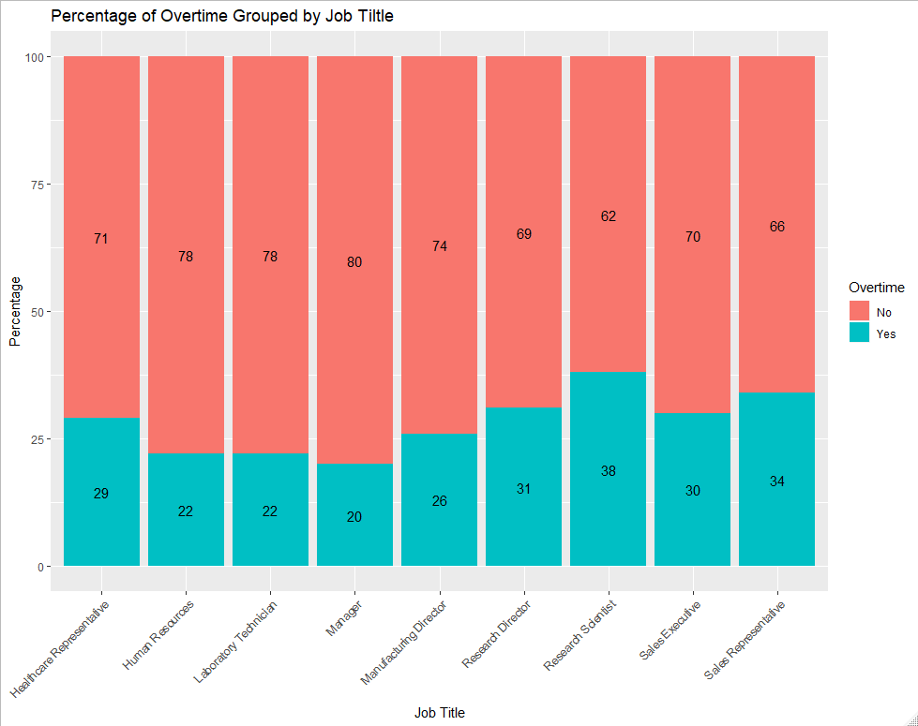

Slide 7
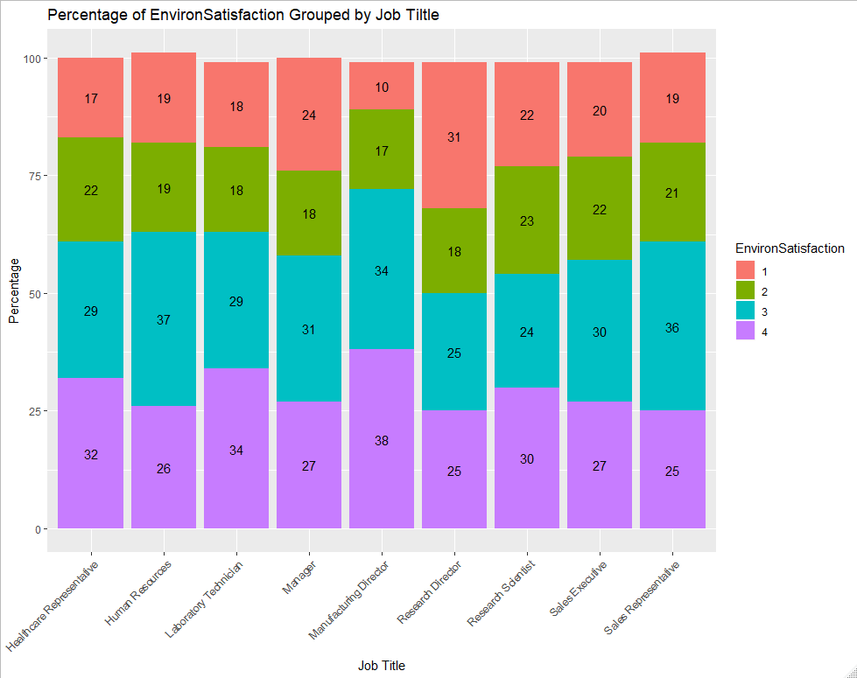
Those with the job title of Manufacturing Director are more satisfied with their environment, given the most aggregate 3s and 4s
Research Directors have the highest frequency of giving the lowest ratings for Environment Satisfaction

Slide 8
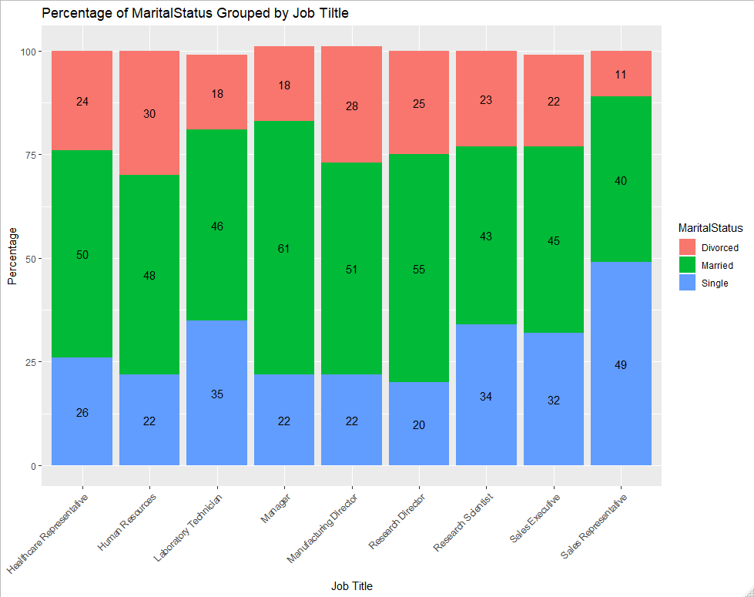
Although close to 50% of the Sales Reps are single, they also are the least likely to be divorced
Managers have the highest marriage percentage, and are tied for the second lowest divorce rate
Over 25% of Manufacturing and Research Directors have been divorced, even though Human Resources has the highest divorce rate

Slide 9
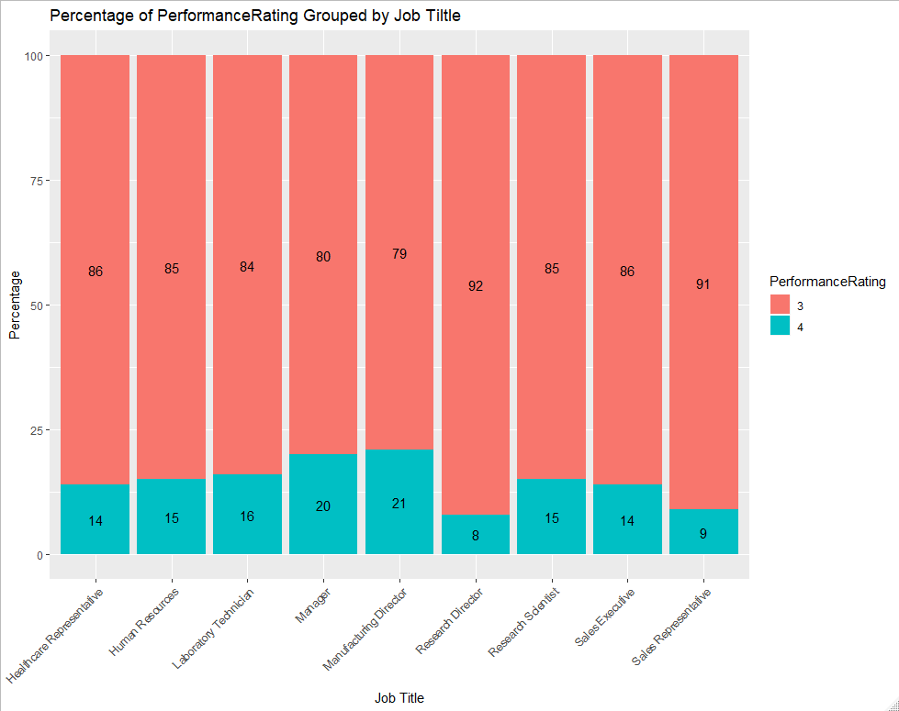
Research Directors and Sales Reps are more likely to give themselves the lower Performance rating of 3 versus 4

Slide 10
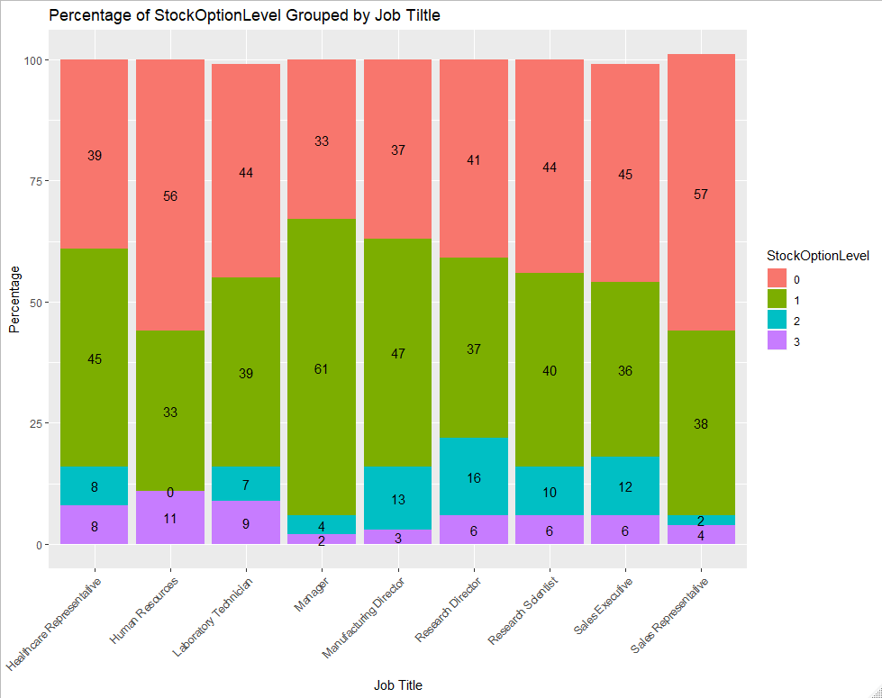
Over 50% of those in Human Resources or work as Sales Reps have a Stock Option Level of 0, but Human Resources also a the highest frequency of Stock Option Level 3s among their group

Slide 11
 | Statistical Description of Continuous Variables Grouped By Job Titles
 | Continuous Variables (medians)
 | Age | DailyRate | DistanceFromHome | HourlyRate | MonthlyIncome | MonthlyRate | #CompaniesWorked | %SalaryInc | Tot.WorkingYrs | TrainingTimesLastYr | YrsAtCompany | YrsInCurrentRole | YrsSinceLastPromotion | YrsWithCurrManager
Job Title
Healthcare Representative | 36.5 | 885 | 8 | 68 | 5755 | 14167 | 1.5 | 14 | 10 | 3.0 | 6 | 4 | 1 | 4
Human Resources | 34 | 823 | 8 | 62 | 3892 | 12830 | 1.5 | 15 | 8 | 3.0 | 5 | 3 | 1 | 3
Laboratory Technician | 35 | 816 | 7 | 65 | 4172 | 13899 | 1.5 | 14 | 9 | 3.0 | 5 | 3 | 1 | 3
Manager | 41 | 758 | 5 | 68 | 10954 | 15325 | 2.0 | 14 | 17 | 3.0 | 9 | 5 | 2 | 5
Manufacturing Director | 35.5 | 834 | 7 | 64 | 5574 | 14199 | 2.0 | 15 | 10 | 2.5 | 6 | 5 | 1 | 4
Research Director | 39.5 | 803 | 8 | 63 | 10460 | 15113 | 2.0 | 14 | 15 | 3.0 | 7 | 5 | 1 | 5
Research Scientist | 35 | 824 | 7 | 67 | 4148 | 13652 | 1.5 | 14 | 9 | 3.0 | 5 | 3 | 1 | 3
Sales Executive | 35.5 | 833 | 8 | 66 | 5154 | 13862 | 1.5 | 14 | 10 | 3.0 | 6 | 3 | 1 | 3
Sales Representative | 33.5 | 790 | 6 | 67 | 3890 | 13606 | 1.5 | 14 | 7 | 3.0 | 4 | 3 | 1 | 3
Group's Aggregate Median: | 35 | 829 | 7 | 66 | 6222 | 13556 | 2 | 14 | 10 | 3 | 7 | 4 | 1 | 4
Healthcare Reps: highest median Daily Rate
Human Resources: lowest Monthly Rate, second youngest group
Managers: Oldest, shortest distance to work, one of the highest paid, and been with the company the longest
Manufacturing Directors: Highest salary increase
Research Directors: second for: oldest group, highest paid, and most total working years
Sales Reps: youngest group, lowest Monthly Income, fewest working years and years at the company
Note: Most positions last promotion was median of 1 year, except Managers who may already be at the top

Slide 12
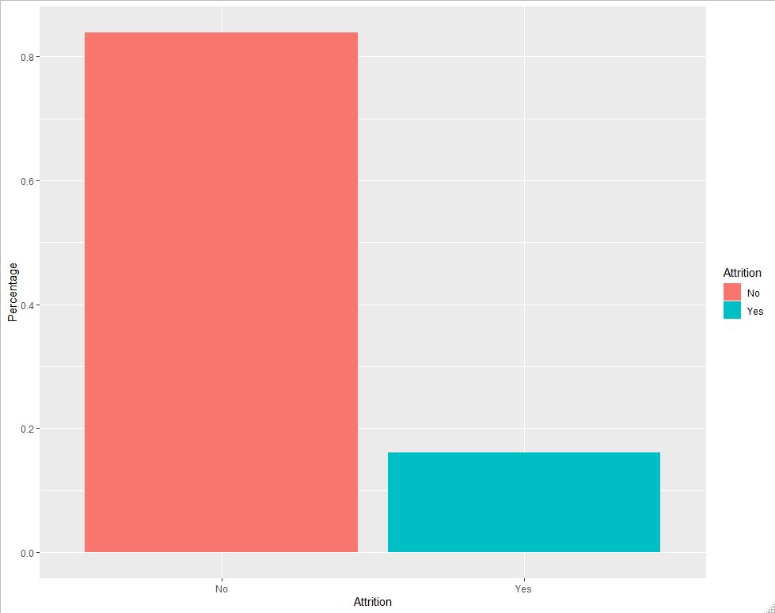
Frito Lay’s Turnover Rate
84%
16%

Slide 13
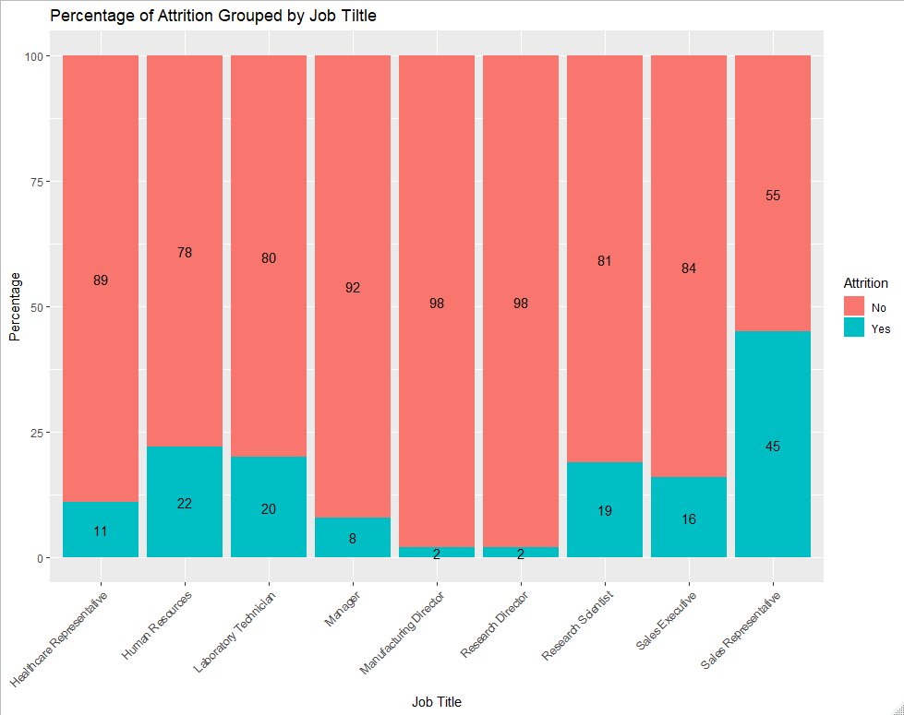
4 Job title with greater than the 84% of the companies overall turnover rate:
Healthcare Representatives
Managers
Manufacturing Directors
Research Directors

Slide 14
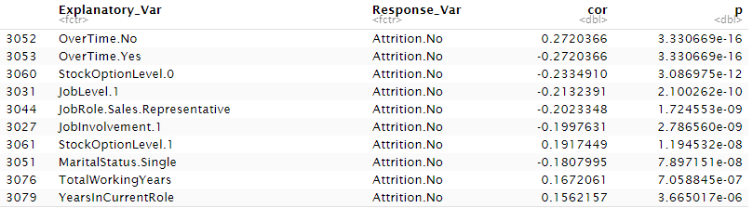
Top 3 Predictors of Attrition
Based on Correlation matrix (with p-values below significance level = 0.05) top 3 predictors of an employee having left in the past were:
Overtime: working overtime was negatively related to leaving
Stock Option Level: those who had stock option level of 0 (Sales rep) were more likely to stay
Job Level: those at Job level 1 were negatively related to an Attrition of No (high retention rate for Sales Reps)

Slide 15
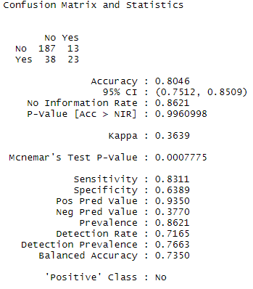
Naïve Bayes Model to Predict Attrition
Variables used for model:
Job Involvement
Job Level
Job Role
Marital Status
Overtime
Stock Option Level
Age
Monthly Income
Total Working Years
Years In Current Role
Years With Current Manager
Model Accuracy (80.46%) failed to meet target level of >= 84% accuracy

Slide 16
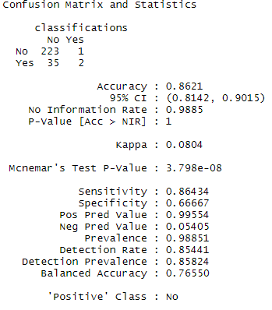
kNN Model to Predict Attrition
Used all continuous variables and k=10
We gain +2% points in accuracy when using this kNN model

Slide 17
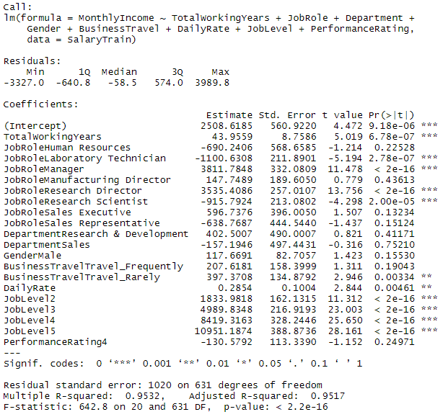
Multi-Linear Regression Model for Salary Prediction
Explanatory Variables:
Total Working Years
Job Role
Department
Gender
Business Travel
Daily Rate
Job Level
Performance Rating
Cross Validation Model with 75/25 split

Slide 18
APPENDIX

Slide 19
CODE for creating correlation matrix and flattenquarematrix function: Citation #1 for Correlation matrix of p-values: Title: correlation matricies: getting p-values? Author: Bill Venables, Statistician, CMIS Environmetrics Project Date: Tue Jan 4 06:05:39 CET 2000 Availability: <https://stat.ethz.ch/pipermail/r-help/2000-January/009758.html> Citation #2 for FlattenSquareMatrix Function: Title: Exploring correlations with R using cor.prob and chart.Correlation Author: Stephen Turner Date: August 27, 2012 Availability: https://gist.github.com/stephenturner/3492773

Slide 20
Access to Resources
Website: adebouse.github.io
Github Repository: https://github.com/adebouse/Case-Study-2.git

Slide 21
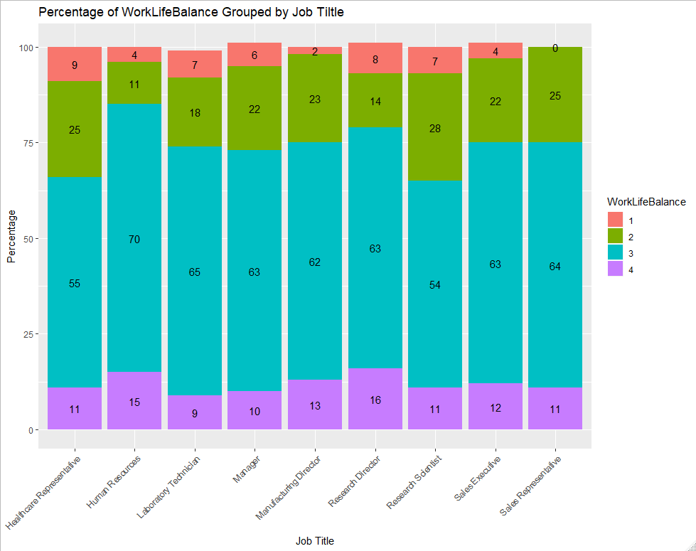
It is very interesting to note that no Sale Reps give the lowest Work Life Balance (1 out of 5), even that is not the typical perspective most people would probably have for that position

Slide 22
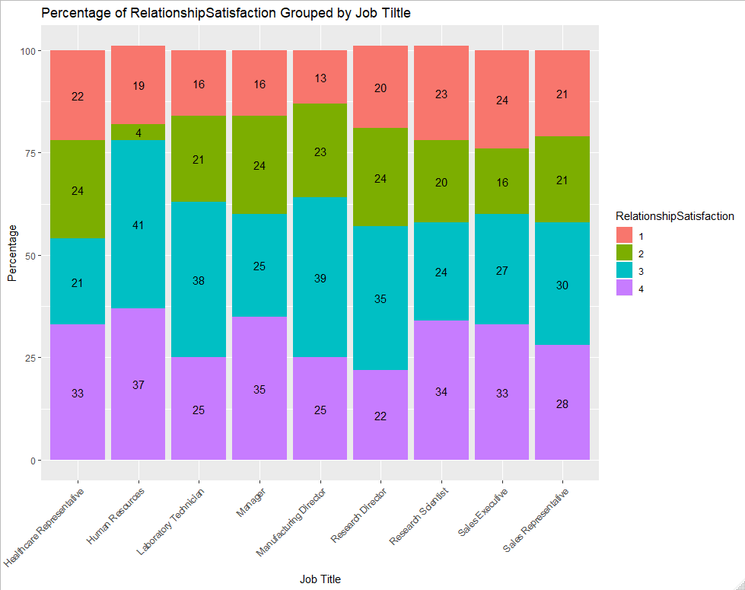

Slide 23
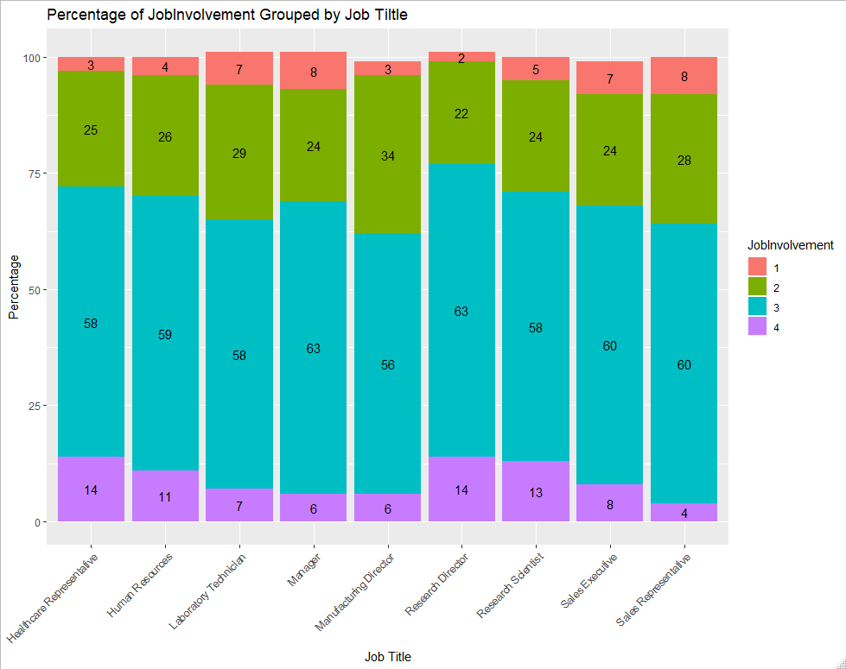

Slide 24
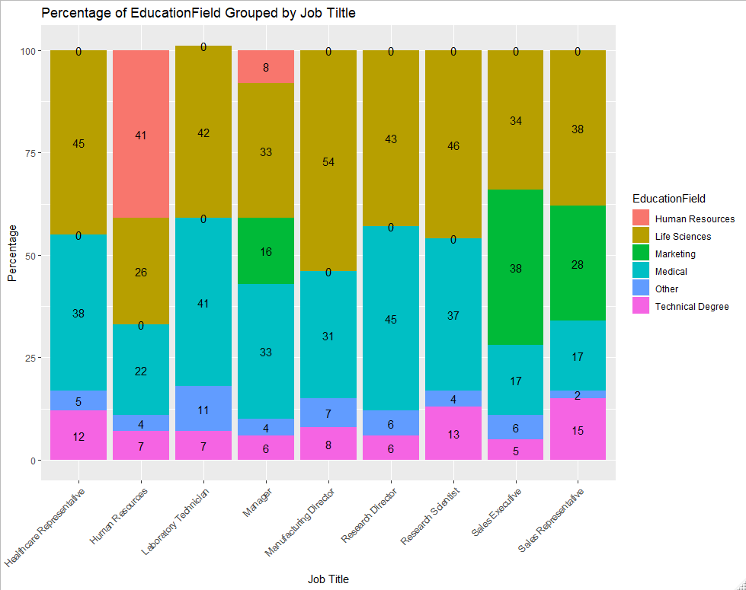
Only those who have the job title of Human Resources of Manager have a Human Resources degree

